Slide 1
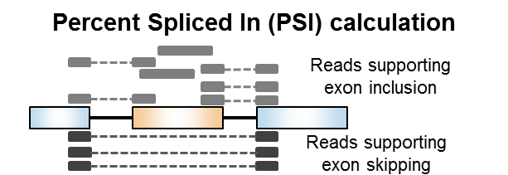
Overview: Measuring splicing using RNA-seq data
Read mapping
to ref. transcriptome
Splicing quantification
and paired differential analysis
using rMTAS (Shen et al. PNAS 2014)
Filter significant
events
dPSI>|10%|
> 5 inclusion or skipping reads per replicate
De novo
transcriptome
reconstruction
PSI=
Inclusion reads
Inclusion + skipping reads

Slide 2
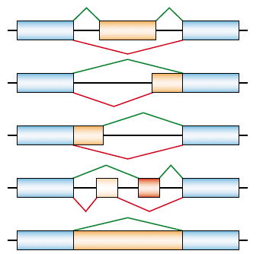
Types of alternative splicing events
Cassette exon
(SE)
Alternative 3’ splice site (A3SS)
Alternative 5’ splice site
(A5SS)
Mutually exclusive exons
(MXE)
Intron retention
(RI)

Slide 3
Differential splicing analysis pipeline steps
Read trimming
Read mapping to ref transcriptome or de novo transcriptome
Assigns groups for rMATS comparison
Run rMATS
Filter significant events, correct gene names
Generate output tables

Slide 4
Differential splicing analysis pipeline output
Two outputs:
Using reference (Gencode) transcriptome *_Ref
Using de novo transcriptome *_Novel
→ Filtered files contain only the significant events differentially spliced between case and control
→ Unfiltered files contain all the events detected
→ Summary table – number of significant events per event type
→ Bigwig files for read coverage for visualization using UCSC browser or IGV

Slide 5
Differential splicing analysis output (Filtered files)
Event type
Long ID for AS events*
PSI Calculation
5’
3’
SE
E1
E2
E3
SE; chr;strand; [E2] Start;End; [E1] Start;End; [E3] Start;End
A3SS; chr;strand; [E2-E3] Start;End; [E1] Start;End; [E3] Start;End
A5SS; chr;strand; [E1-E2] Start;End; [E1] Start;End; [E3] Start;End
MXE; chr;strand; [E2] Start;End; [E3]Start;End; [E1] Start;End; [E4] Start;End
RI; chr;strand; [E2] Start;End; [E1] Start;End; [E3] Start;End
*Exon coordinates are from left to right. regardless of gene orientation
WT
MUT
A3SS
E1
E2
E3
PSI1
PSI2
A5SS
E1
E2
E3
MXE
E1
E2
E3
E4
dPSI = mPSI2 – mPSI1
short ID for AS events*
RI
E1
E2
E3
dPSI (+) Higher inclusion in MUT
dPSI (-) Lower inclusion in MUT
SE; chr;strand; [E2] Start;End; [E1] End; [E3] Start
A3SS; chr;strand; [E2] Start;End; [E1] End; [E3] Start
A5SS; chr;strand; [E2] Start;End; [E1] End; [E3] Start
MXE; chr;strand; [E2] Start;End; [E3]Start;End; [E1] End; [E4] Start;
RI; chr;strand; [E2] Start;End; [E1] End; [E3] Start;
*Exon coordinates are from left to right. regardless of gene orientation
Exon coordinates (5’→3’) E1-E2-E3
Sequences (5’→3’) S1-S2-S3

Slide 6
Differential splicing analysis output (Filtered files)
1. Type of alternative event
16. Average PSI control
3. Gene name
17. Average PSI case
18. ∆PSI (Case-Control)
>0 more included, <0 more skipped
30. Event ID and sequences for BLAST
5-8. Reads supporting inclusion or skipping for control (1) and case (2) for each replicate
9-10. PSI for control (1) and case (2) for each replicate

Slide 7
Header | Description
Event type | Type of event: SE (skipped exon or cassette exon), RI (retained intron ), A3'SS (alternate 3' splice site or AA), A5'SS (alternate 5' splice site or AD) or MXE (mutually exclusive exon or MX)
Short ID | Short ID of DSEs, nomeclature include event type and 5'-3' coordinate of spliced sequence.
Long ID | Unique ID of DSEs, nomeclature include event type and 5'-3' coordinate of spliced sequence.
GeneName | Official gene symbol
ENSEMBL_ID | ENSEMBL ID
strand | strand (+) or (-)
IC1 | Read counts that support inclusion of a spliced region for each biological replicate separated by ";" in control
SC1 | Read counts that support skipping of a spliced region for each biological replicate separated by ";" in control
IC2 | Read counts that support inclusion of a spliced region for each biological replicate separated by ";" in case
SC2 | Read counts that support skipping of a spliced region for each biological replicate separated by ";" in case
PS1 | Percent Spliced In or inclusion level for each biological replicate separated by ";" in control
PS2 | Percent Spliced In or inclusion level for each biological replicate separated by ";" in case
mIC1 | Mean IC1
mSC1 | Mean SC1
mIC2 | Mean IC2
mSC2 | Mean SC2
mPSI1 | Mean PSI1
mPSI2 | Mean PSI2
dPSI (2-1) | difference in PSI (PSI2 - PSI1)
P-value | rMATS P-value
FDR | rMATS false discovery rate
E1 | genomic coordinates for the 5' end of the upstream exon; 3' end of the upstream exon
E2 | genomic coordinates for the 5' end of the spliced region; 3' end of the spliced region (for MXE event, this is the first mutually exclusive exon)
E3 | genomic coordinates for the 5' end of the downstream exon; 5' end of the downstream exon (for MXE event, this is the second mutually exclusive exon)
E4 | genomic coordinates for the 5' end of the downstream exon; 3' end of the downstream exon for MXE event
S1 | upstream exon sequence
S2 | spliced exon sequence
S3 | downstream exon (for MXE this is the second exon)
S4 | downstream exon sequence for MXE
MIN_RECIPRO | Filtering (1 Yes, 0 No) for min 5 reads for IC1 OR IC2 AND 5 reads for SC1 OR SC2
genome | version of reference genome assembly
BLAT | fasta formatted event ID and sequences of E1-E2-E3-E4

Slide 8
Visualizing RNA-seq bw files on UCSC genome browser
Create bw files with UCSC coordinates (e.g., "chr1" instead of "1")
2) Transfer files to JAX FTP server
connect using WinSCP via SCP or SFTP protocol
server: jaxbhftp02.jax.org
login: anczukow-lab
password: 5DSgc4c0aYaGk24gQOLAqgZb
copy files to folder
check that you see files here: ftp://ftp.jax.org/anczukow-lab and right click to copy link location
3) Load files to UCSC genome browser
Login to UCSC- create login if needed
MyData>CustomTracks
For each bw file add the name and ftp location:
track type=bigWig name="Sample_Name" description="Sample_description" color=0,51,204 bigDataUrl=ftp://ftp.jax.org/anczukow-lab/file_name.bw

Slide 9
Visualizing RNA-seq bw files on UCSC genome browser
Color examples:
blue: color=0,51,204
red: color=179,0,0
green: color=0,102,0
purple: color=89,0,179
other https://www.w3schools.com/colors/colors_picker.asp
Submit and add custom track
More here: https://genome.ucsc.edu/goldenpath/help/bigWig.html
4) Save and share the tracks
MyData>MySession
Add name and save session
Share session with collaborators.
5) BLAT the sequences from filtered table

